Slide 1
Library management system
Relaxed style presentation
23.04.24
Duan Youzhen&Ding Yeming

Slide 2
Tasks
Books can be added or deleted
Searchable book
View the details of the book

Slide 3
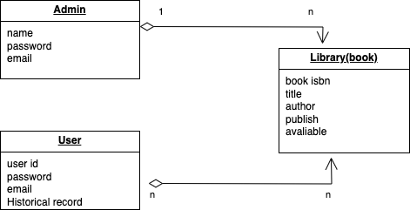
Class diagram

Slide 4
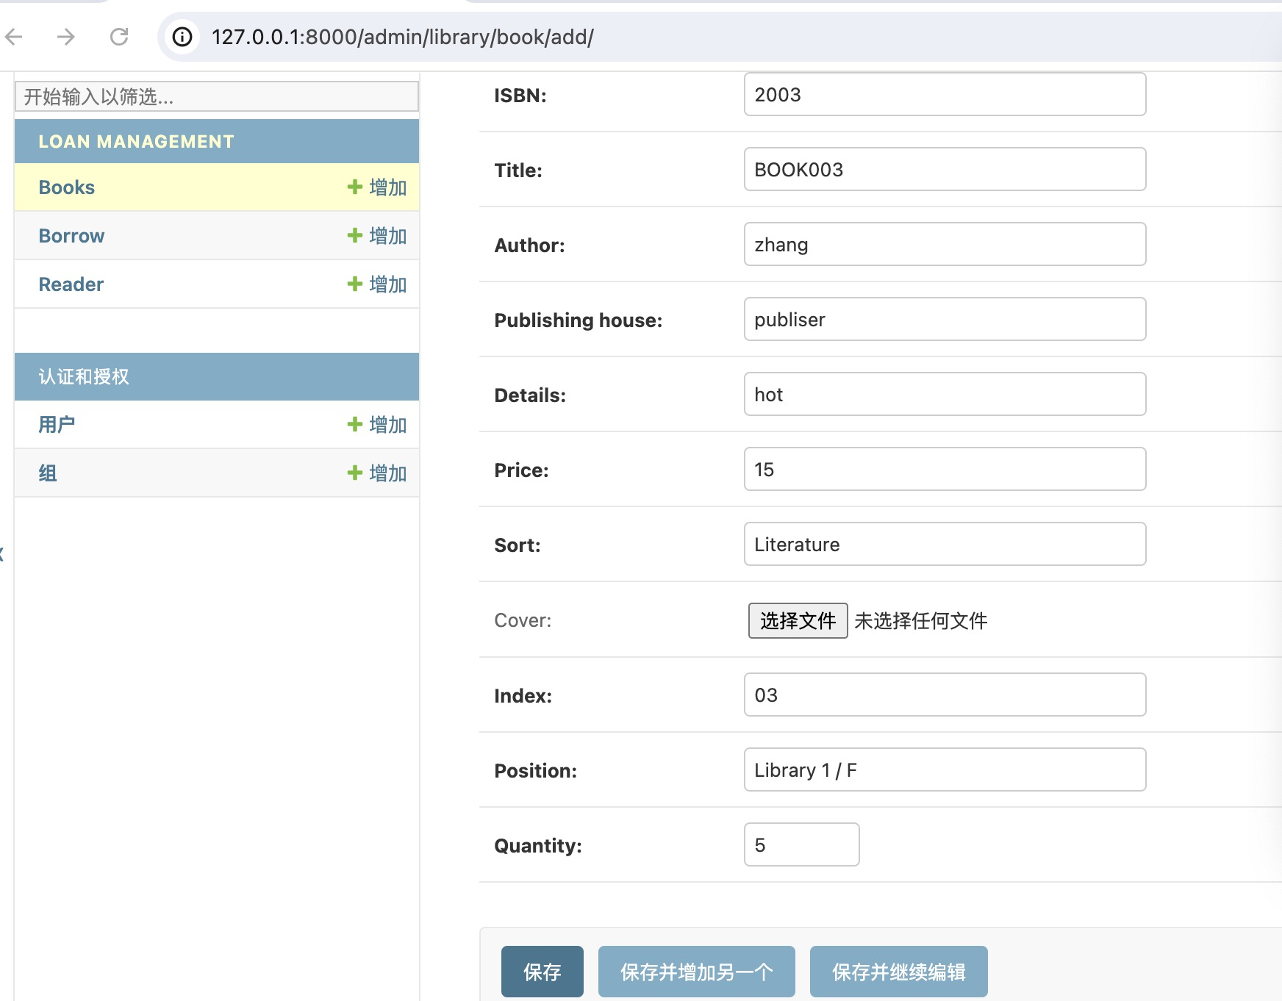

Slide 5
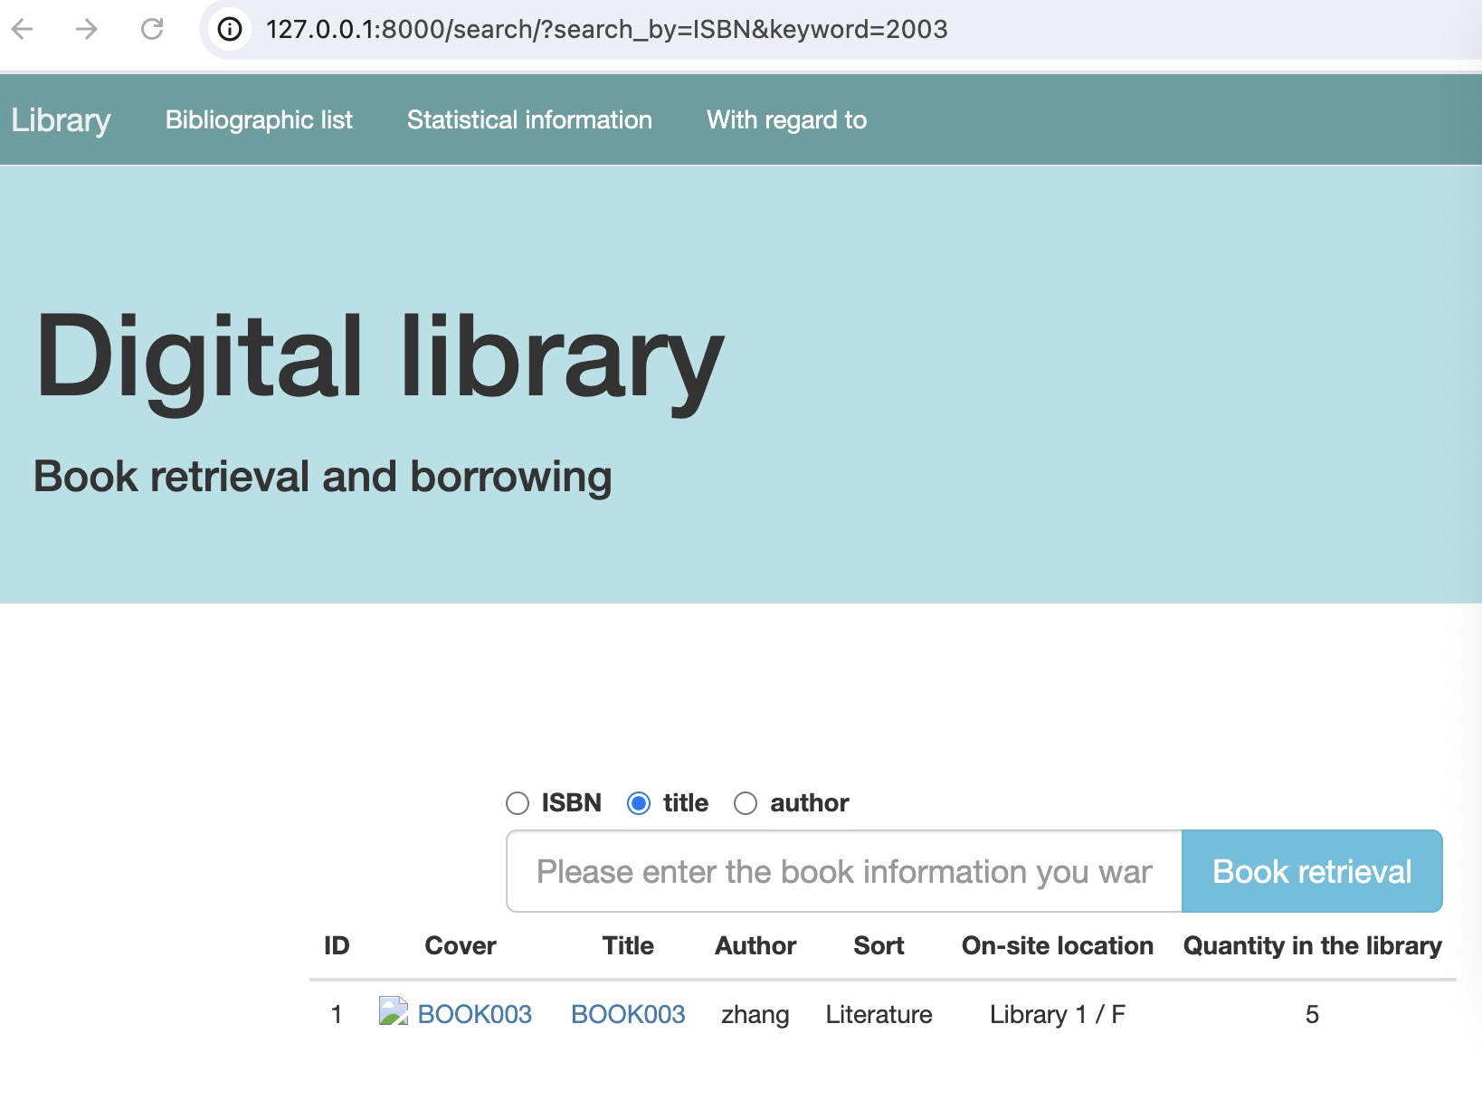
The administrator enters a book in the background, which can be retrieved on the home page

Slide 6
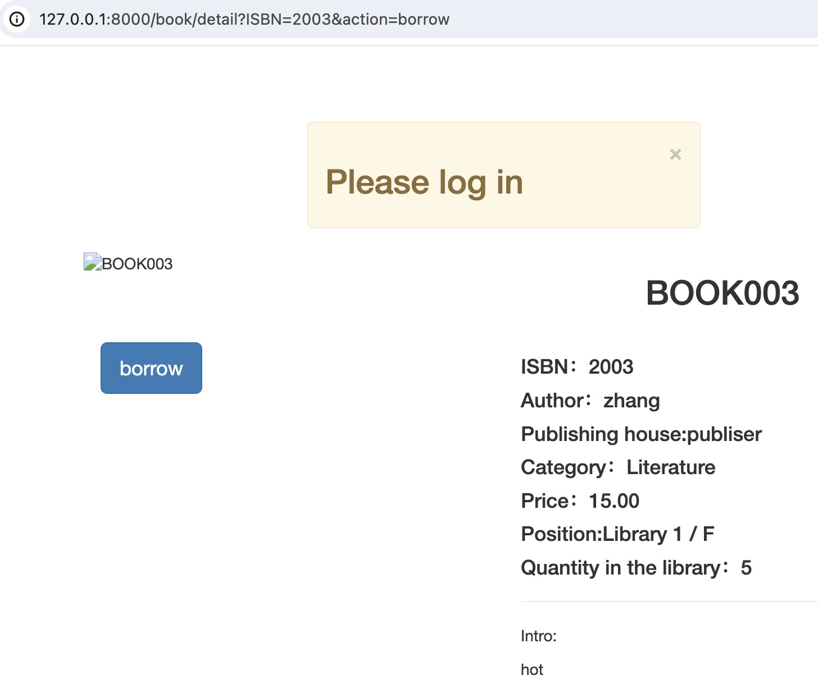
A detailed description of this book can be viewed in tourist mode. To borrow, login is required

